Slide 1
FINAL DATA ANALYTICS PROJECT
INDONESIA E-COMMERCE
SALES ANALYSIS
Order Performance • Payment • Shipping • Cancellation
Final Presentation | 2026

Slide 2
Project Overview
Scope, analytical objectives, and business questions
• Analyze Indonesian e-commerce order performance.
• Evaluate completion and cancellation patterns.
• Compare payment methods and shipping options.
• Identify recorded cancellation patterns and potential operational issues.
• Translate findings into measurable business recommendations.
Indonesia E-Commerce Sales Analysis | 02

Slide 3
Dataset & Data Preparation
Dataset profile and key quality treatments
RECORDS
COLUMNS
UNIQUE ORDER ID
DATE RANGE
18,868
23
18,868
2023–2025
• Missing payment methods were categorized as Tidak Diketahui.
• Invalid and missing order dates were repaired using Waktu Pesanan Dibuat.
• COD payment labels were standardized.
• Missing quantity values were retained because safe imputation was not available.
• The clean dataset preserves all 18,868 source records.
Indonesia E-Commerce Sales Analysis | 03

Slide 4
Executive KPI Snapshot
Overall order status and payment indicators
TOTAL ORDERS
COMPLETED
COMPLETION RATE
CANCELLATION RATE
18,868
16,045
85.04%
13.64%
TOTAL ORDER PAYMENT
COMPLETED ORDER PAYMENT
Rp 962,091,801
Rp 950,963,704
Payment values are order payment amounts, not profit or net revenue.
Indonesia E-Commerce Sales Analysis | 04

Slide 5
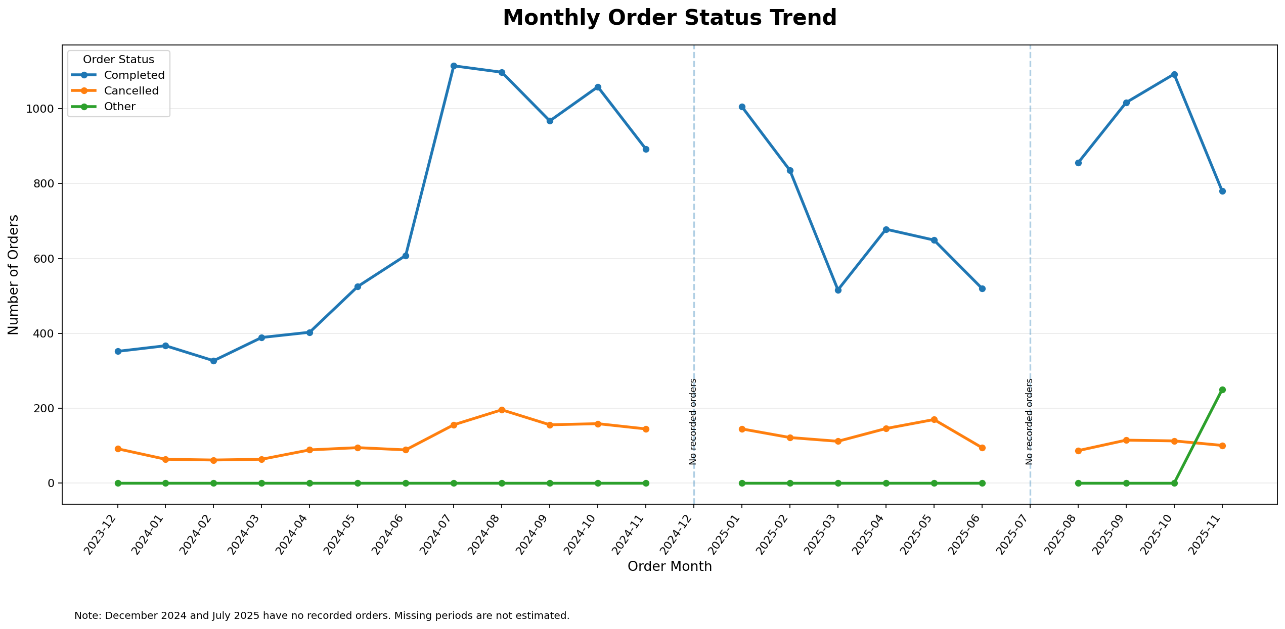
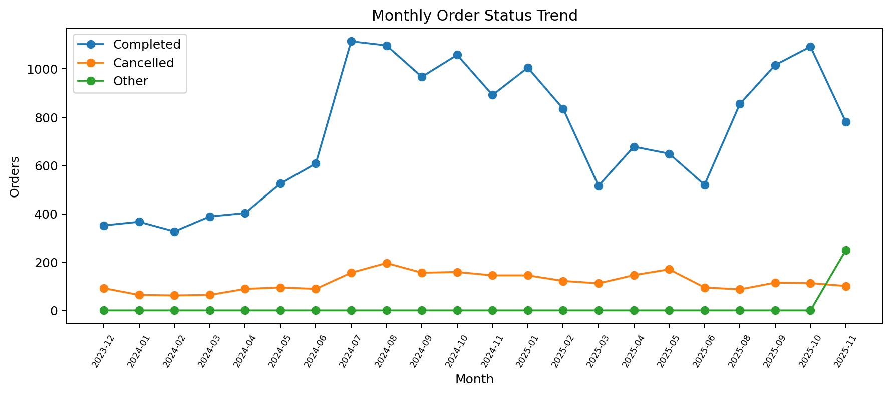
Monthly Order Trend
Monthly distribution of completed, cancelled, and other statuses
Indonesia E-Commerce Sales Analysis | 05

Slide 6
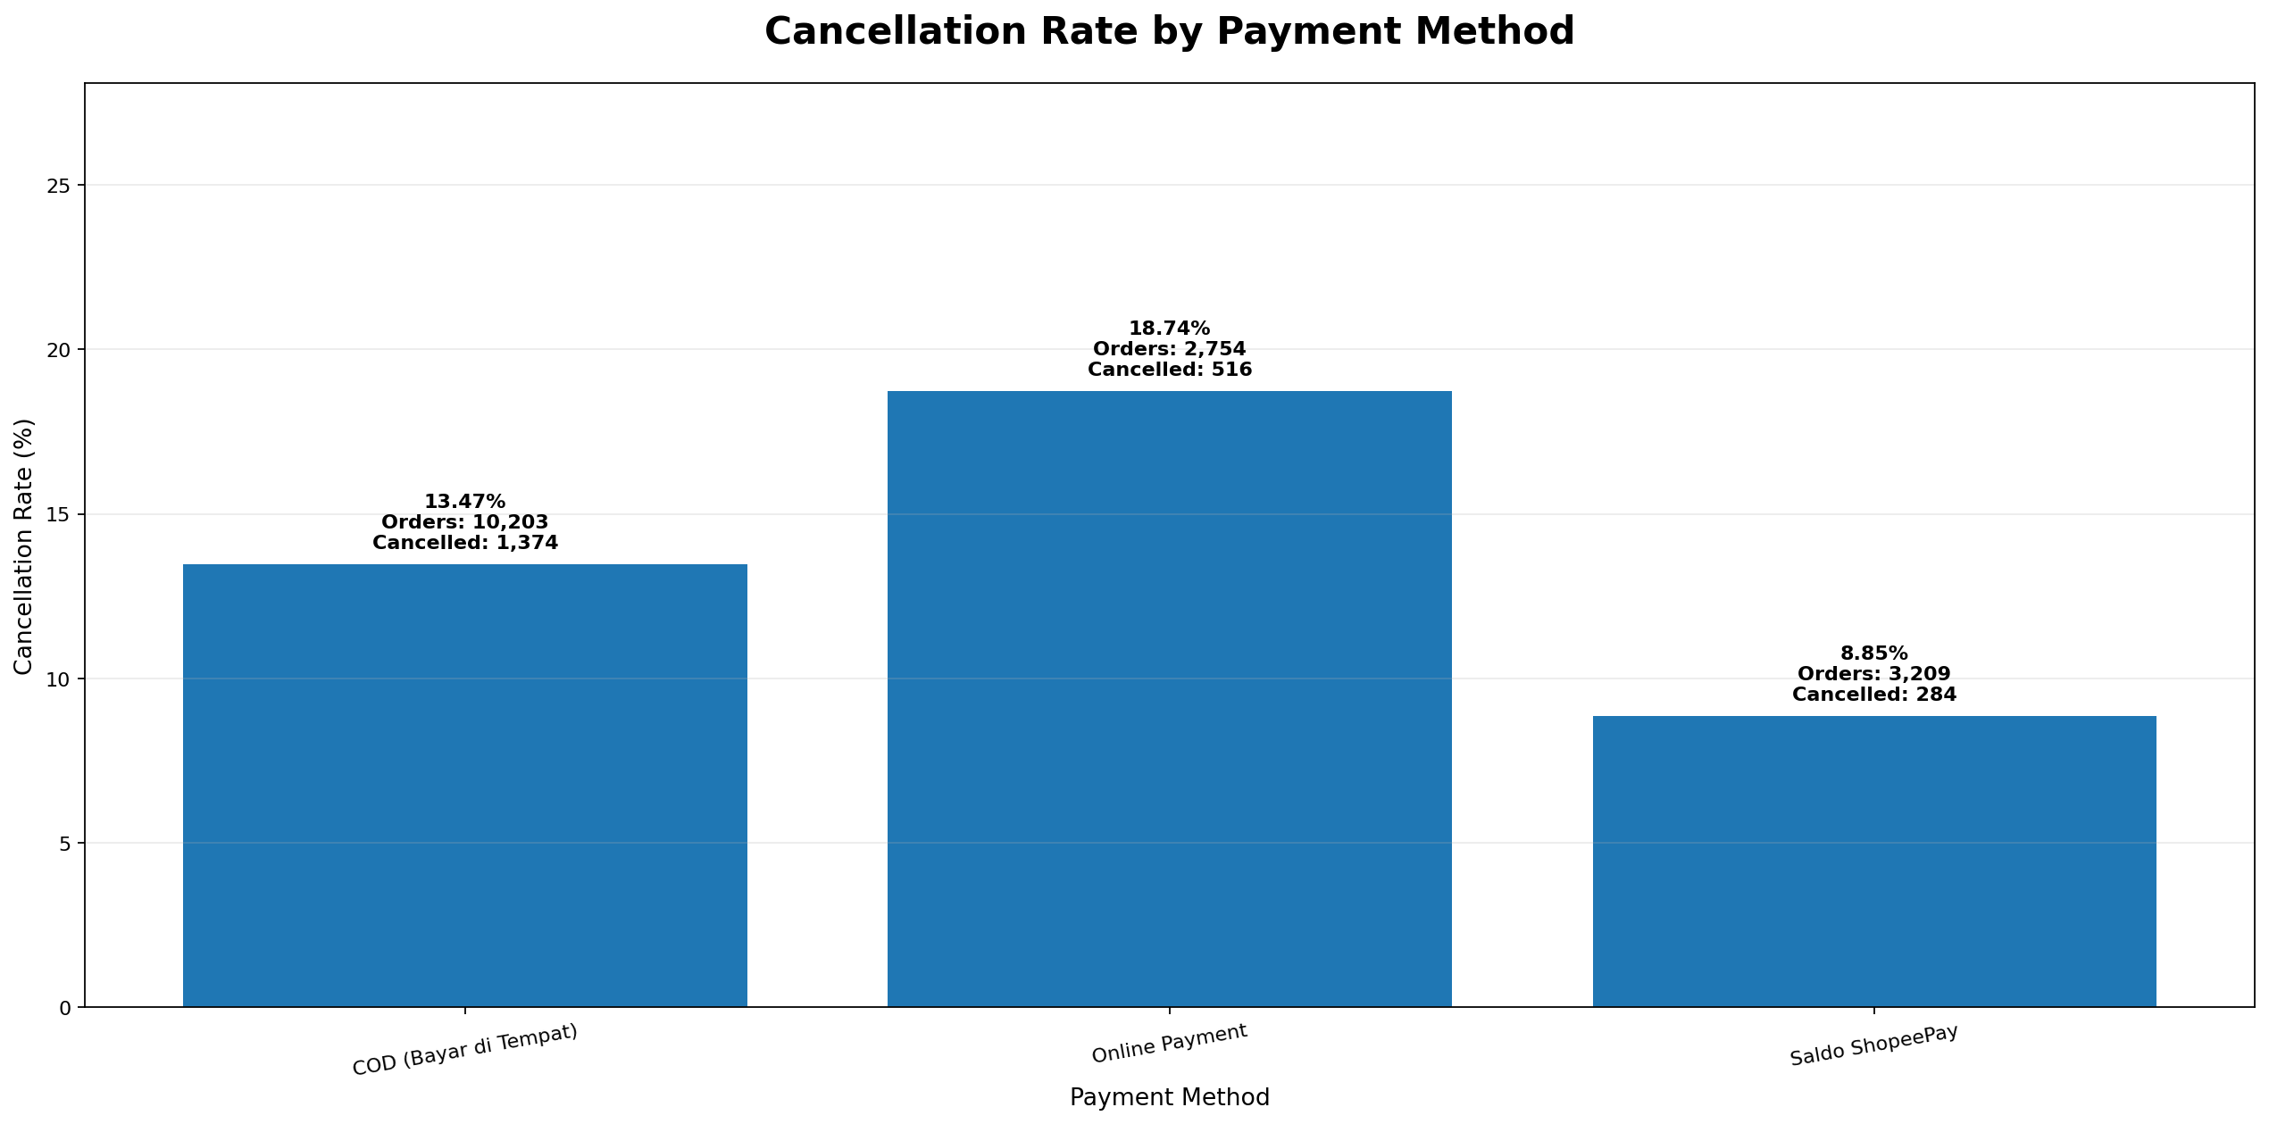
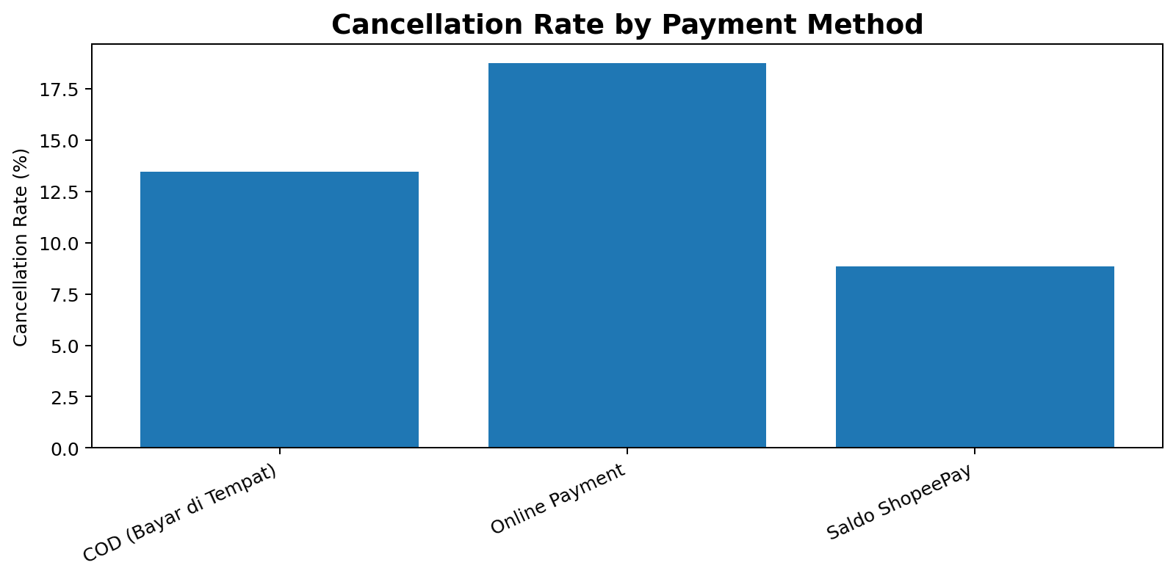
Payment Method Analysis
Comparison of three major payment categories
• COD: 84.89% completion | 13.47% cancellation
• Online Payment: 80.28% completion | 18.74% cancellation
• Saldo ShopeePay: 90.28% completion | 8.85% cancellation
Indonesia E-Commerce Sales Analysis | 06

Slide 7
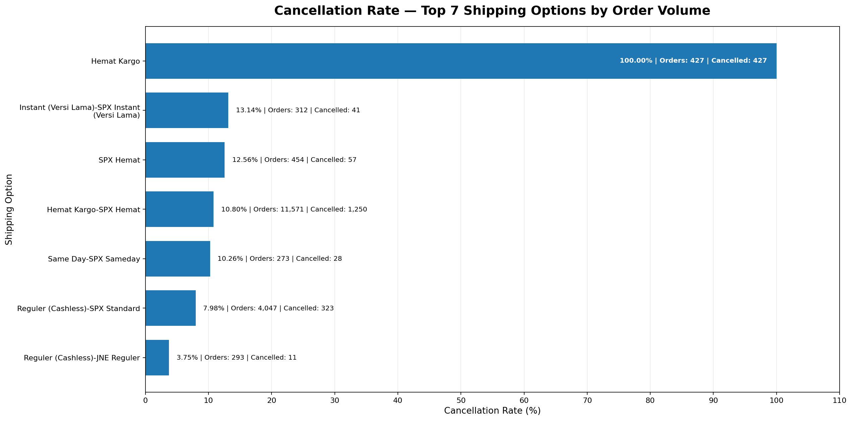
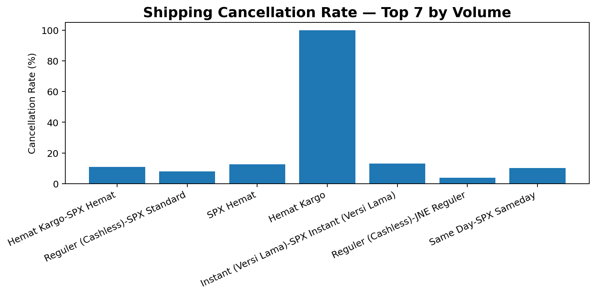
Shipping Analysis
Shipping options and recorded cancellation patterns
Anomalies: Hemat Kargo (427/427 cancelled) and Reguler (Cashless) (160/160 cancelled).
These patterns require operational and recording verification; they do not establish shipping as the cause.
Indonesia E-Commerce Sales Analysis | 07

Slide 8
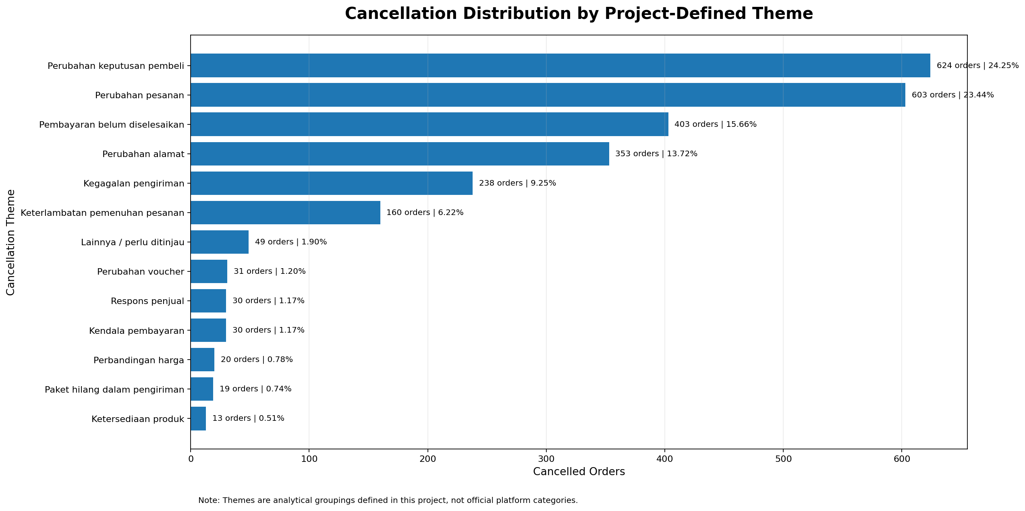
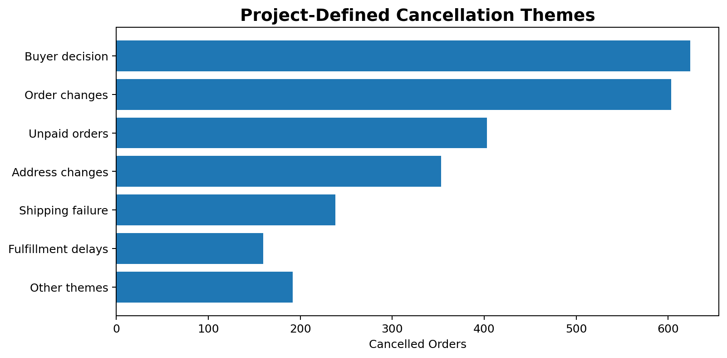
Cancellation Analysis
Project-defined grouping of recorded cancellation reasons
Four largest themes: 1,983 orders (77.07% of cancellations).
Indonesia E-Commerce Sales Analysis | 08

Slide 9
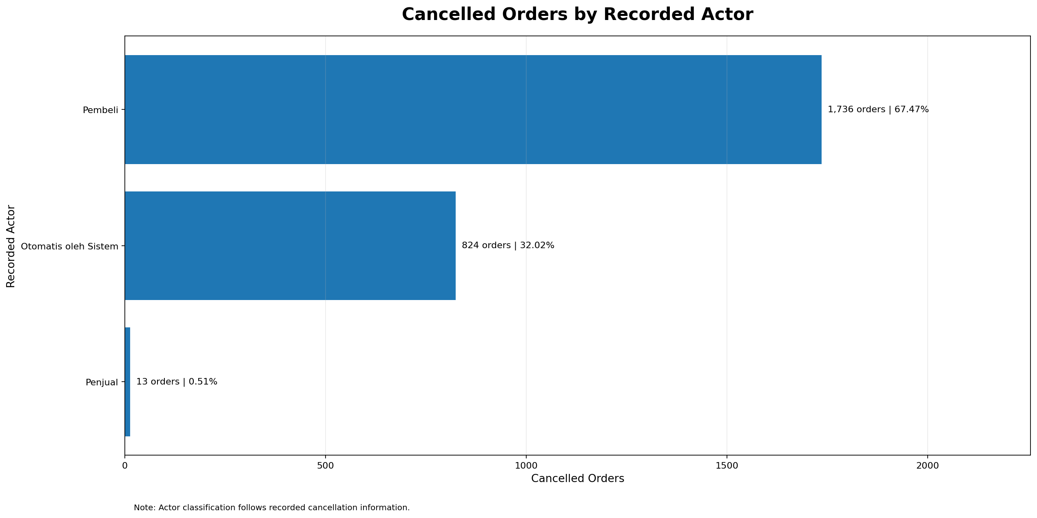
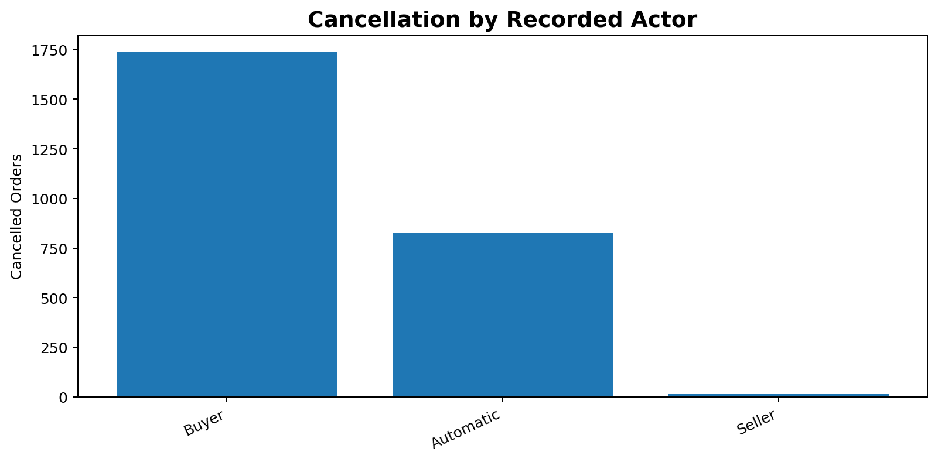
Cancellation Behavior
Recorded cancellation actor distribution
• Buyer: 1,736 cancellations (67.47%).
• Automatic: 824 cancellations (32.02%).
• Seller: 13 cancellations (0.51%).
Indonesia E-Commerce Sales Analysis | 09

Slide 10
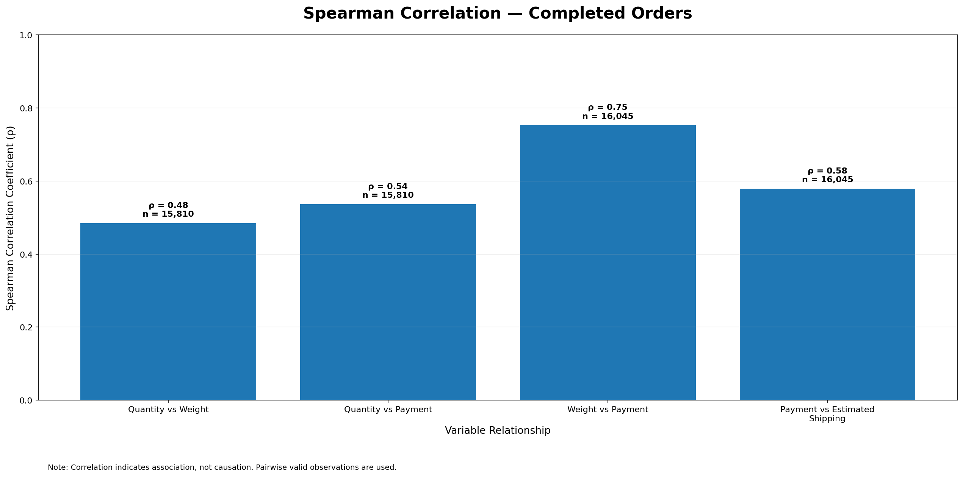
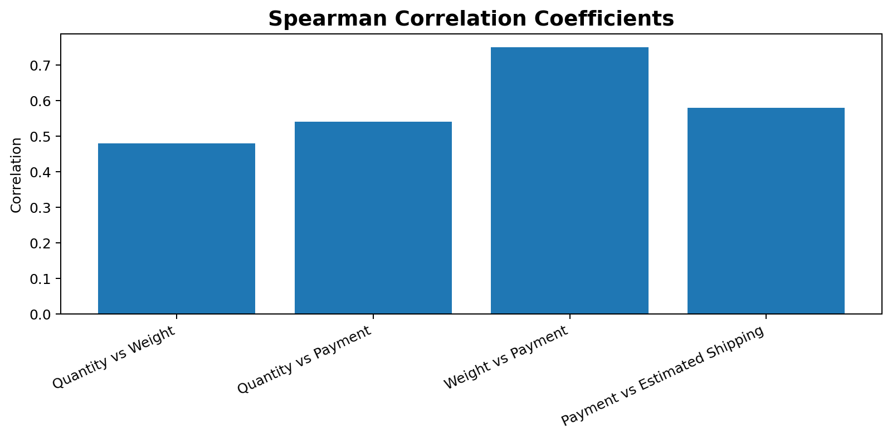
Multivariate Analysis
Spearman rank correlations among completed orders
Strongest observed association: weight vs payment (ρ = 0.75).
Correlation indicates association, not causation.
Indonesia E-Commerce Sales Analysis | 10

Slide 11
Business Recommendations
Prioritized actions based on recorded cancellation patterns
• HIGH — Buyer decision: improve product information and expectation setting.
• HIGH — Order changes: strengthen order confirmation and modification workflow.
• HIGH — Unpaid orders: review payment reminders and payment completion flow.
• HIGH — Address changes: validate delivery addresses before fulfillment.
• HIGH — Shipping failure: investigate delivery and tracking exceptions.
• MEDIUM — Fulfillment delays: monitor seller dispatch performance.
• MEDIUM — Stock availability: improve stock synchronization.
Indonesia E-Commerce Sales Analysis | 11

Slide 12
KPI Monitoring Framework
Operational measures to track improvement over time
Completion Rate
Completed Orders / Total Orders × 100
Cancellation Rate
Cancelled Orders / Total Orders × 100
Buyer Decision Rate
Buyer Decision Cancellations / Total Orders × 100
Order Change Rate
Order Change Cancellations / Total Orders × 100
Unpaid Order Rate
Unpaid Cancellations / Total Orders × 100
Shipping Failure Rate
Shipping Failure Cancellations / Total Orders × 100
Fulfillment Delay Rate
Fulfillment Delay Cancellations / Total Orders × 100
Indonesia E-Commerce Sales Analysis | 12

Slide 13
Data Limitations & Analytical Cautions
Boundaries of interpretation
• No Cost of Goods Sold (COGS): profit and ROI cannot be calculated.
• No Customer ID: unique customer behavior cannot be measured.
• Missing quantity values were retained; 283 records have missing quantity.
• Product categories can be multi-category per order.
• Cancellation reasons are recorded labels, not verified causal evidence.
• 250 other statuses are not necessarily failed orders.
• No return reasons are available.
• Correlation does not establish causation.
Indonesia E-Commerce Sales Analysis | 13

Slide 14
CONCLUSION
Order completion is strong, but cancellation remains a key area for operational improvement.
• Completion rate: 85.04%.
• Cancellation rate: 13.64%.
• Four largest cancellation themes account for 77.07%.
• Prioritize buyer decision, order changes, unpaid orders, and address changes.
• Monitor operational KPIs and validate hypotheses with further data.
Indonesia E-Commerce Sales Analysis | 14

